Slide 1
BITS Pilani
Dr. Lavika Goel
Assistant Professor
Department of CSIS
Lecture 3: 3/2/2019
Pilani Campus

Slide 2
Pilani Campus
Dictionaries and Tolerant Retrieval
2/2/2019 SS ZG537 (INFORMATION RETRIEVAL) 2

Slide 3
Today’s Agenda
Dictionary data structures
“Tolerant” retrieval
Wild ‐ card queries
Spell correction: Document Correction, Query mis-spellings
Isolated word correction, Context-sensitive spell correction
Soundex
2/2/2019 SS ZG537 (INFORMATION RETRIEVAL) 3
Pilani Campus

Slide 4
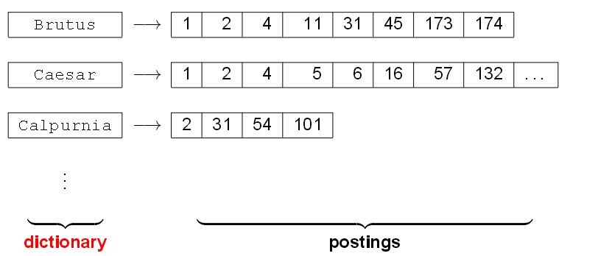
Dictionary data structures for Inverted Indexes
The dictionary data structures stores the term Vocabulary, Document Frequency, Pointers to each posting lists…in what Data Structure?
2/2/2019 SS ZG537 (INFORMATION RETRIEVAL) 4
Pilani Campus

Slide 5
Storing Dictionaries
For each term, we need to store a couple of items:
document frequency
pointer to postings list
. . .
Assume for the time being that we can store this information in a fixed-length entry.
Assume that we store these entries in an array.
2/2/2019 SS ZG537 (INFORMATION RETRIEVAL) 5
Pilani Campus

Slide 6
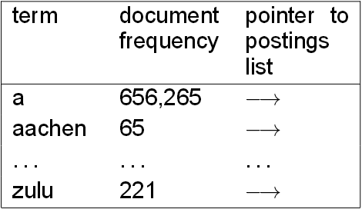
Storing Dictionaries (2)
An Array of
structures
char(20) int Postings*
space needed: 20 bytes 4/8 bytes 4/8 bytes
How do we look up an element in this array at query time?
Remember: these dictionaries can be huge, scanning is not an option
2/2/2019 SS ZG537 (INFORMATION RETRIEVAL) 6
Pilani Campus

Slide 7
Dictionary Data Structures
Two main classes of data structures: hash tables and trees.
Criteria for when to use hash tables vs. trees:
Is there a fixed number of terms or will it keep growing?
What are the relative frequencies with which various keys will be accessed?
How many terms are we likely to have?
2/2/2019 SS ZG537 (INFORMATION RETRIEVAL) 7
Pilani Campus

Slide 8
Hash Tables
Each vocabulary term is hashed into an integer.
Try to avoid collisions
At query time, do the following: hash query term, resolve collisions, locate entry in fixed-width array.
Pros:
Lookup in a hash table is faster than lookup in a tree.
Cons:
No prefix search (all terms starting with automat) [tolerant retrieval]
Need to rehash everything periodically if vocabulary keeps growing.
2/2/2019 SS ZG537 (INFORMATION RETRIEVAL) 8
Pilani Campus

Slide 9
Trees
Trees solve the prefix problem (find all terms starting With automat).
Simplest tree: binary tree
Binary trees are problematic:
Only balanced trees allow efficient retrieval
Rebalancing binary trees is expensive
Use B-trees
Solves the prefix problem.
Slower O(log M) [ and this requires the balanced tree]
Rebalancing is expensive
2/2/2019 SS ZG537 (INFORMATION RETRIEVAL) 9
Pilani Campus

Slide 10
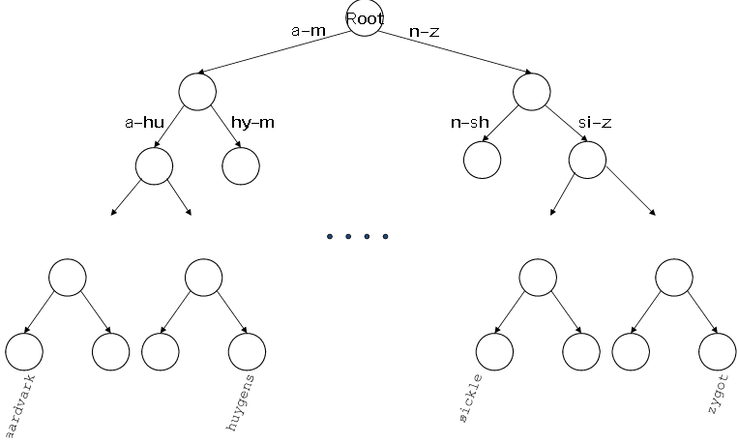
Binary Tree
2/2/2019 SS ZG537 (INFORMATION RETRIEVAL) 10
Pilani Campus

Slide 11
Root
M-N
A-K
A-G
H-K
A-K
M-N
H-J
Ka-Ke
An-As
B-G
An-Ar
Go-Gu
Assam
B-C
Andhra Pradesh
Arunachal Pradesh
Bihar
Chhattisgarh
Goa
Gujarath
2/2/2019 SS ZG537 (INFORMATION RETRIEVAL) 11

Slide 12
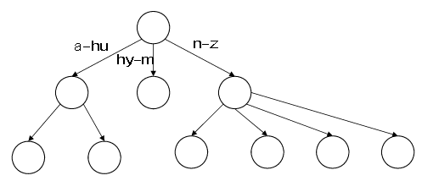
B-Tree
Definition: Every internal node has a number of children
in the interval [a,b] where a,b are appropriate natural
numbers, e.g.,[2,4].
2/2/2019 SS ZG537 (INFORMATION RETRIEVAL) 12
Pilani Campus

Slide 13
Wildcard Queries
mon*: find all docs containing any term beginning with mon
Easy with B-tree dictionary: retrieve all terms t in the range: mon ≤ t < moo
* mon: find all docs containing any term ending with mon
Maintain an additional tree for terms backwards
Then retrieve all terms t in the range: nom ≤ t < non
How do we enumerate all the terms meeting the wild card query pro*cent?
2/2/2019 SS ZG537 (INFORMATION RETRIEVAL) 13
Pilani Campus

Slide 14
Query Processing
At this point, we have an enumeration of all terms in the dictionary that match the wildcard query.
We still have to look up the postings for each enumerated term.
E.g., consider the query: Jayasur*a, Sana* Jayasur*
This may result in the execution of many Boolean AND queries.
2/2/2019 SS ZG537 (INFORMATION RETRIEVAL) 14
Pilani Campus

Slide 15
Wildcards in Middle of Term
Example: m*nchen
We could look up m*and*nchen in the B-tree and intersect the two term sets.
Expensive (there are probably thousands and thousands of terms beginning with “m”)
Alternative: permuterm index
Basic idea: Rotate every wildcard query, so that the * occurs at the end.
2/2/2019 SS ZG537 (INFORMATION RETRIEVAL) 15
Pilani Campus

Slide 16
Permuterm index
For term hello, index under:
hello$,ello$h,llo$he,lo$hel,o$hell,$hello where$ is a special symbol.
Queries: where X=hel and Y=o
X lookup on X$ X* lookup on $ X*
X*Y lookup on Y$ X* Y*Z ???
2/2/2019 SS ZG537 (INFORMATION RETRIEVAL) 16
Pilani Campus

Slide 17
K-gram index
A K-gram is sequence of K characters .
More space-efficient than permuterm index
Enumerate all character k-grams (sequence of k characters) occurring in a term 2-grams are called bigrams
Example: from April is the cruelest month
$ is a special word boundary symbol.
Maintain an inverted index from bigrams to the terms that contain the bigram
$a,ap,pr,ri,il,l$,$i,is,s$,$t,th,he,e$,$c,cr,ru,
ue,el,le,es,st,t$, $m,mo,on,nt,h$
2/2/2019 SS ZG537 (INFORMATION RETRIEVAL) 17
Pilani Campus

Slide 18
2-gram examples
Dictionary : All possible K-grams generated form the terms
Postings : All terms containing that K-gram sorted in lexicographic
order
Postings are terms in the inverted index
ap
Apple
April
map
Query: mon*
Bigrams for query: $m, mo,on
$m AND mo AND on
All terms staring with m and containing
Mo and containing on
$m
mace
madden
mo
among
amortize
on
along
among
2-gram index for the term moon
2/2/2019 SS ZG537 (INFORMATION RETRIEVAL) 18
Pilani Campus

Slide 19
Processing wild card query
As before, we must execute a Boolean query for each enumerated, filtered term.
Wild-cards can result in expensive query execution (very large disjunctions…)
pyth* AND prog*
If you encourage “laziness” people will respond!
Search
Type your search terms, use ‘*’ if you need to.
E.g., Alex* will match Alexander.
2/2/2019 SS ZG537 (INFORMATION RETRIEVAL) 19
Pilani Campus

Slide 20
Summary
Arrays, Hash tables or tress are commonly used as dictionary data structures.
B-tree dictionary is most suitable if the wild card queries are to be answered.
K-grams indexes are suitable to answer complex queries.
2/2/2019 SS ZG537 (INFORMATION RETRIEVAL) 20
Pilani Campus

Slide 21
Pilani Campus
Spelling Correction
2/2/2019 SS ZG537 (INFORMATION RETRIEVAL) 21

Slide 22
Spell correction
Two principal uses
Correcting document(s) being indexed
Correcting user queries to retrieve “right” answers
Two main flavors:
Isolated word
Check each word on its own for misspelling
Will not catch typos resulting in correctly spelled words
e.g., from → form
Context-sensitive
Look at surrounding words,
e.g., I flew form Heathrow to Narita.
2/2/2019 SS ZG537 (INFORMATION RETRIEVAL) 22
Pilani Campus

Slide 23
Document correction
Especially needed for OCR’ed documents
Correction algorithms are tuned for this: rn/m
Can use domain-specific knowledge
E.g., OCR can confuse O and D more often than it would confuse O and I (adjacent on the QWERTY keyboard, so more likely interchanged in typing).
But also: web pages and even printed material have typos
Goal: the dictionary contains fewer misspellings
But often we don’t change the documents and instead fix the query-document mapping
2/2/2019 SS ZG537 (INFORMATION RETRIEVAL) 23
Pilani Campus

Slide 24
Query mis-spellings
Our principal focus here
E.g., the query Alanis Morisett
We can either
Retrieve documents indexed by the correct spelling, OR
Return several suggested alternative queries with the correct spelling
Did you mean … ?
2/2/2019 SS ZG537 (INFORMATION RETRIEVAL) 24
Pilani Campus

Slide 25
Isolated word correction
Fundamental premise – there is a lexicon from which the correct spellings come
Two basic choices for this
A standard lexicon such as
Webster’s English Dictionary
An “industry-specific” lexicon – hand-maintained
The lexicon of the indexed corpus
E.g., all words on the web
All names, acronyms etc.
(Including the mis-spellings)
2/2/2019 SS ZG537 (INFORMATION RETRIEVAL) 25
Pilani Campus

Slide 26
Isolated word correction
Given a lexicon and a character sequence Q, return the words in the lexicon closest to Q
What’s “closest”?
We’ll study several alternatives
Edit distance (Levenshtein distance)
Weighted edit distance
n-gram overlap
2/2/2019 SS ZG537 (INFORMATION RETRIEVAL) 26
Pilani Campus

Slide 27
Edit distance
Given two strings S₁ and S₂, the minimum number of operations to convert one to the other
Operations are typically character-level
Insert, Delete, Replace, (Transposition)
E.g., the edit distance from dof to dog is 1
From cat to act is 2 (Just 1 with transpose.)
from cat to dog is 3.
Generally found by dynamic programming.
2/2/2019 SS ZG537 (INFORMATION RETRIEVAL) 27
Pilani Campus

Slide 28
Example
E(X,Y) = Edit distance between X and Y
E(i,j) = Edit distance between X[1..i] and Y[1..j]
E(0,0) = 0
E(1,0) = 1
E(k,0) = k
E(0,k) = k
Base Cases
2/2/2019 SS ZG537 (INFORMATION RETRIEVAL) 28
Pilani Campus

Slide 29
Example
 | 0 | 1 (y₁) | 2(y₂) | 3(y₃) |  | n(y_{n})
0 | 0 | 1 | 2 | 3 |  | n
1(x₁)
2(x₂)
3(x₃)
m(x_{m})
 | 0 | N | E | T | W | O | R | K | S
0 | 0 | 1 | 2 | 3 | 4 | 5 | 6 | 7 | 8
C | 1
A | 2
T | 3
S | 4
2/2/2019 SS ZG537 (INFORMATION RETRIEVAL) 29
Pilani Campus

Slide 30
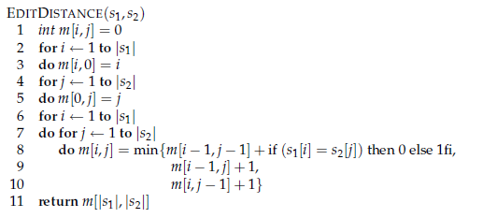
Algorithm
2/2/2019 SS ZG537 (INFORMATION RETRIEVAL) 30
Pilani Campus

Slide 31
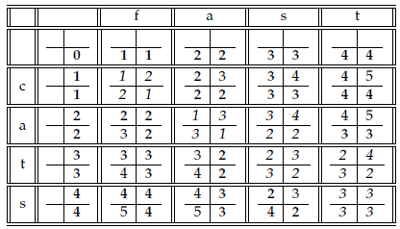
Levenshtein distance (Edit distance) computation
The 2 by 2 cell in the [i, j] entry of the table shows the three numbers whose minimum yields the fourth. The cells in italics determine the edit distance.
2/2/2019 SS ZG537 (INFORMATION RETRIEVAL) 31
Pilani Campus

Slide 32
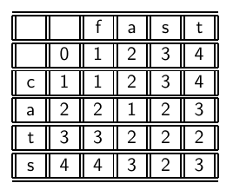
Levenshtein Distance: Example
2/2/2019 SS ZG537 (INFORMATION RETRIEVAL) 32
32
Pilani Campus

Slide 33
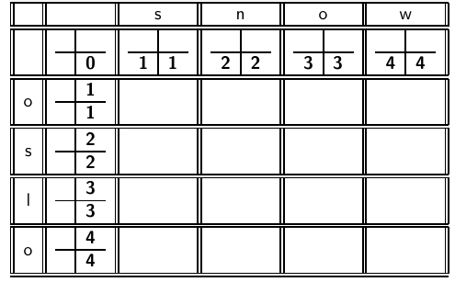
Levenshtein Distance: Example
2/2/2019 SS ZG537 (INFORMATION RETRIEVAL) 33
33
Pilani Campus

Slide 34
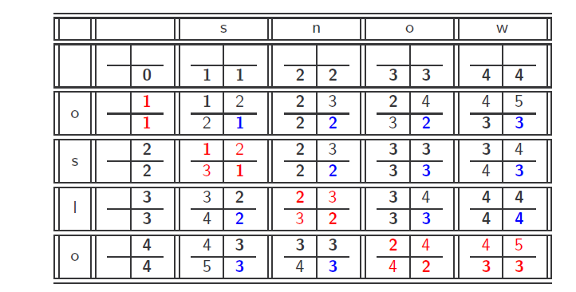
Levenshtein Distance: Example
2/2/2019 SS ZG537 (INFORMATION RETRIEVAL) 34
Pilani Campus

Slide 35
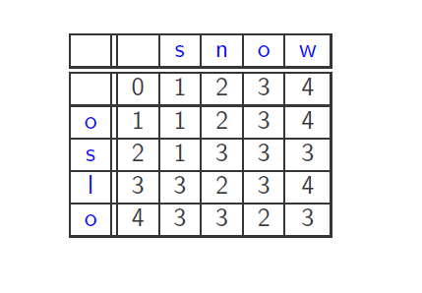
Levenshtein Distance: Example
2/2/2019 SS ZG537 (INFORMATION RETRIEVAL) 35
Pilani Campus

Slide 36
Weighted edit distance
As above, but the weight of an operation depends on the character(s) involved
Meant to capture OCR or keyboard errors Example: m more likely to be mis-typed as n than as q
Therefore, replacing m by n is a smaller edit distance than by q
This may be formulated as a probability model
Requires weight matrix as input
Modify dynamic programming to handle weights
2/2/2019 SS ZG537 (INFORMATION RETRIEVAL) 36
Pilani Campus

Slide 37
Using edit distances
Given query, first enumerate all character sequences within a preset (weighted) edit distance (e.g., 2)
Intersect this set with list of “correct” words
Show terms you found to user as suggestions
Alternatively,
We can look up all possible corrections in our inverted index and return all docs … slow
We can run with a single most likely correction
The alternatives disempower the user, but save a round of interaction with the user
2/2/2019 SS ZG537 (INFORMATION RETRIEVAL) 37
Pilani Campus

Slide 38
Edit distance to all dictionary terms?
Given a (mis-spelled) query – do we compute its edit distance to every dictionary term?
Expensive and slow
Alternative?
How do we cut the set of candidate dictionary terms?
One possibility is to use n-gram overlap for this
This can also be used by itself for spelling correction.
2/2/2019 SS ZG537 (INFORMATION RETRIEVAL) 38
Pilani Campus

Slide 39
n-gram overlap
Enumerate all the n-grams in the query string as well as in the lexicon
Use the n-gram index (recall wild-card search) to retrieve all lexicon terms matching any of the query n-grams
Threshold by number of matching n-grams
Variants – weight by keyboard layout, etc.
2/2/2019 SS ZG537 (INFORMATION RETRIEVAL) 39
Pilani Campus

Slide 40
Example with trigrams
Suppose the text is november
Trigrams are nov, ove, vem, emb, mbe, ber.
The query is december
Trigrams are dec, ece, cem, emb, mbe, ber.
So 3 trigrams overlap (of 6 in each term)
How can we turn this into a normalized measure of overlap?
2/2/2019 SS ZG537 (INFORMATION RETRIEVAL) 40
Pilani Campus

Slide 41
One option – Jaccard coefficient
A commonly-used measure of overlap
Let X and Y be two sets; then the J.C. is
Equals 1 when X and Y have the same elements and zero when they are disjoint
X and Y don’t have to be of the same size
Always assigns a number between 0 and 1
Now threshold to decide if you have a match
E.g., if J.C. > 0.8, declare a match
2/2/2019 SS ZG537 (INFORMATION RETRIEVAL) 41
Pilani Campus

Slide 42
Matching trigrams
Consider the query lord – we wish to identify words matching 2 of its 3 bigrams (lo, or, rd)
lo
alone
lore
sloth
or
border
lore
morbid
rd
ardent
border
card
Standard postings “merge” will enumerate …
Adapt this to using Jaccard (or another) measure.
2/2/2019 SS ZG537 (INFORMATION RETRIEVAL) 42
Pilani Campus

Slide 43
Context-sensitive spell correction
Text: I flew from Heathrow to Narita.
Consider the phrase query “flew form Heathrow”
We’d like to respond
Did you mean “flew from Heathrow”?
because no docs matched the query phrase.
2/2/2019 SS ZG537 (INFORMATION RETRIEVAL) 43
Pilani Campus

Slide 44
Context-sensitive correction
Need surrounding context to catch this.
First idea: retrieve dictionary terms close (in weighted edit distance) to each query term
Now try all possible resulting phrases with one word “fixed” at a time
flew from heathrow
fled form heathrow
flea form heathrow
Hit-based spelling correction: Suggest the alternative that has lots of hits. (Corpus , Query)
2/2/2019 SS ZG537 (INFORMATION RETRIEVAL) 44
Pilani Campus

Slide 45
Soundex
Class of heuristics to expand a query into phonetic equivalents
Language specific – mainly for names
E.g., chebyshev → tchebycheff
Invented for the U.S. census … in 1918
2/2/2019 SS ZG537 (INFORMATION RETRIEVAL) 45
Pilani Campus

Slide 46
Soundex – typical algorithm
Turn every token to be indexed into a 4-character reduced form
Do the same with query terms
Build and search an index on the reduced forms
(when the query calls for a soundex match)
http://www.creativyst.com/Doc/Articles/SoundEx1/SoundEx1.htm#Top
2/2/2019 SS ZG537 (INFORMATION RETRIEVAL) 46
Pilani Campus

Slide 47
Soundex – typical algorithm
Retain the first letter of the word.
Change all occurrences of the following letters to '0' (zero): 'A', E', 'I', 'O', 'U', 'H', 'W', 'Y'.
Change letters to digits as follows:
B, F, P, V → 1
C, G, J, K, Q, S, X, Z → 2
D,T → 3
L → 4
M, N → 5
R → 6
2/2/2019 SS ZG537 (INFORMATION RETRIEVAL) 47
Pilani Campus

Slide 48
Soundex continued
Remove all pairs of consecutive digits.
Remove all zeros from the resulting string.
Pad the resulting string with trailing zeros and return the first four positions, which will be of the form <uppercase letter> <digit> <digit> <digit>.
E.g., Herman becomes H655.
Will hermann generate the same code?
2/2/2019 SS ZG537 (INFORMATION RETRIEVAL) 48
Pilani Campus

Slide 49
Soundex
Soundex is the classic algorithm, provided by most databases (Oracle, Microsoft, …)
How useful is soundex?
Not very – for information retrieval
Okay for “high recall” tasks (e.g., Interpol), though biased to names of certain nationalities
Zobel and Dart (1996) show that other algorithms for phonetic matching perform much better in the context of IR
2/2/2019 SS ZG537 (INFORMATION RETRIEVAL) 49
Pilani Campus

Slide 50
Summary
Spelling Correction at the indexing part will be done if your search engine corpus contains documents that are scanned.
Two approaches for spelling correction
Isolated word correction ( Edit Distance, Weighted edit distance, K-gram)
Context Sensitive correction
Nice, easy reading on spell correction:
Peter Norvig: How to write a spelling corrector
http://norvig.com/spell-correct.html
2/2/2019 SS ZG537 (INFORMATION RETRIEVAL) 50
Pilani Campus

